Slide 1
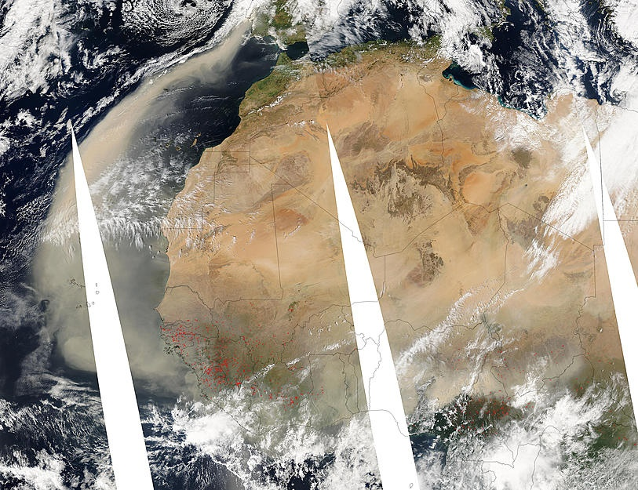
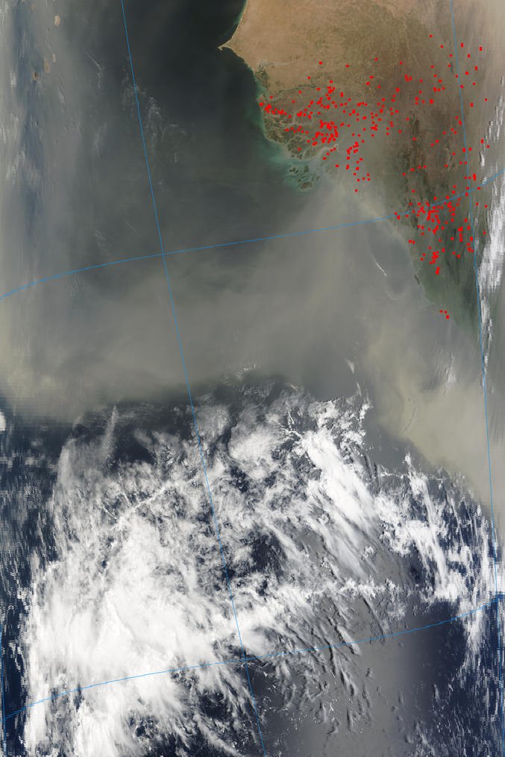
The Maiden Voyage of AEROSE was during March 2004
03/05 at 14 :05 UTC
Dust advection from Central and West Africa
Satellite: Aqua - Pixel size: 8km
03/05 at 12 :40 UTC
Dust over Cape Verde Islands
Satellite: Terra - Pixel size: 1km

Slide 2
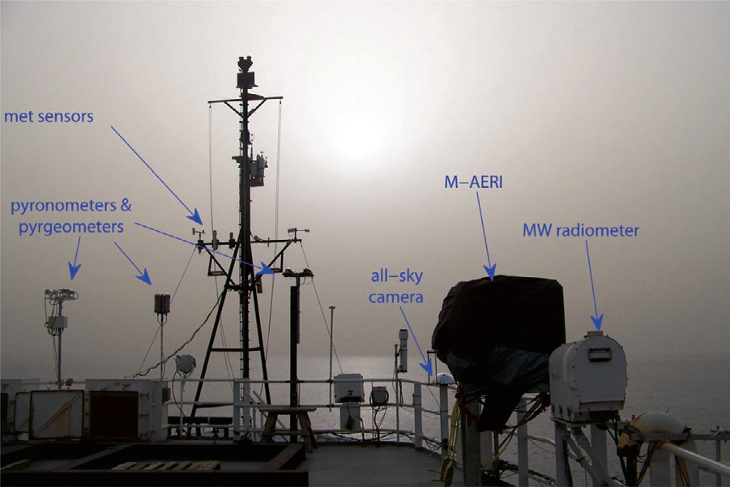
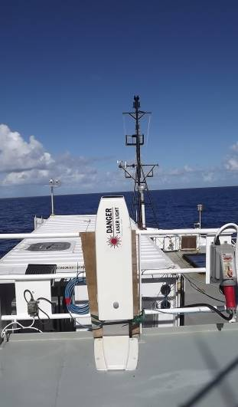
Profiling the
Atmosphere
Unenhanced digital color photograph of the forward 02 level of the Ronald H. Brown during the major Saharan dust outflow 13 May 2007 (Nalli et al. 2011)
Notes:
Fig. 7. Unenhanced digital
color photograph of the forward
02 level of the Ronald
H. Brown, taken while holding
station along 23°W longitude
during PNE/AEROSE-III, on
the afternoon of 13 May 2007,
during the major Saharan dust
outflow pulse shown in Fig. 6.
Some AEROSE instrumentation
visible in the foreground,
from left: broadband flux radiometers
(i.e., pyranometers
and pyrgeometers), all-sky
camera, M-AERI, and microwave
(MW) radiometer.

Slide 3
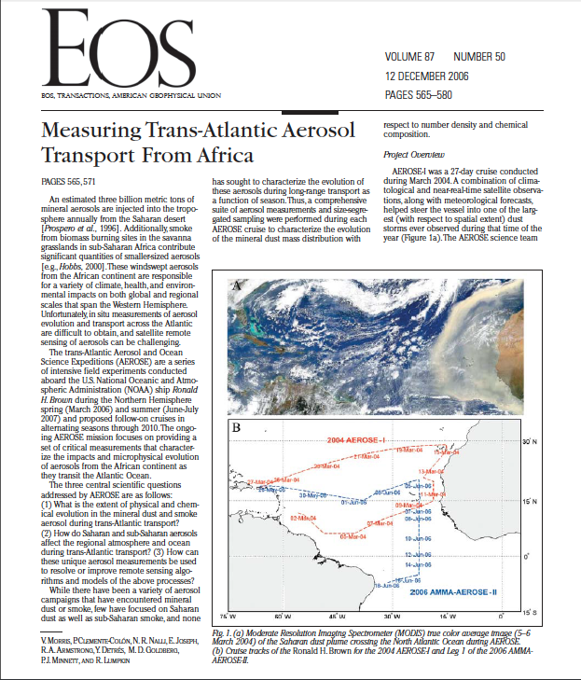

Notes:
The AEROSE science team divides the primary project into three main components aligned with each of the objectives; 1) Aerosol Chemistry, 2) Atmospheric Physics, and 3) Satellite Science and Cal/Val. As the project has continued distinctive components associated with oceanography, aerobiology, and climate have evolved
AEROSE Objectives
To characterize aerosols in air mass outflows originating from West Africa during trans-Atlantic transport.
To investigate the regional atmospheric and oceanic impacts of these air masses.
To enhance weather forecast models and validate satellite data

Slide 4
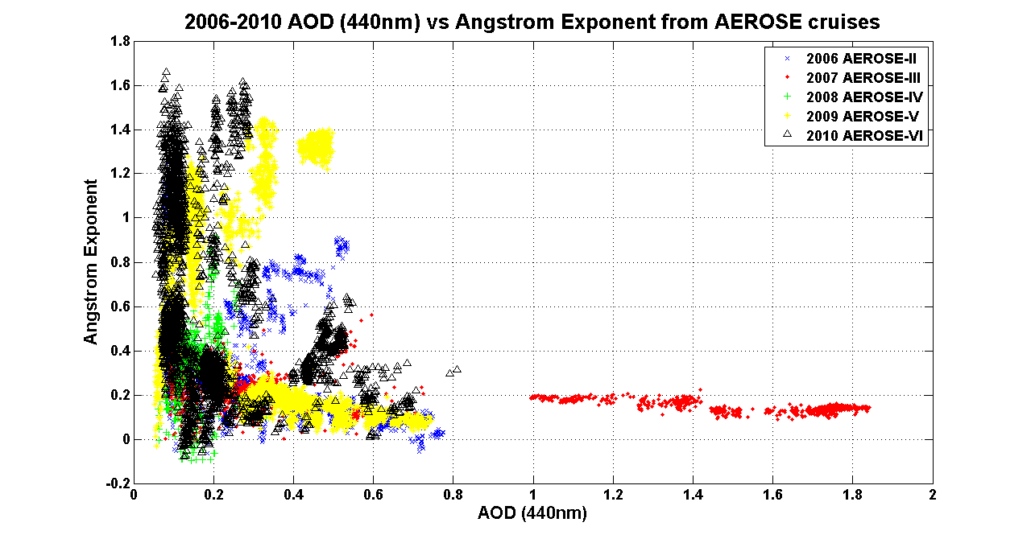
Aerosol Classification from AEROSE
April – May 2010 Pollution Outflow WA and east coast US
Jul Aug 2009 Extreme Biomass
Burning Event
Jun Jul 2006 Moderate Biomass
Burning Event
Range of moderate and extreme aerosol events
Classifying dust, smoke, urban pollution
May 2007 Extreme Dust Event
Jun Jul 2006 and 2009 Moderate Dust Events

Slide 5
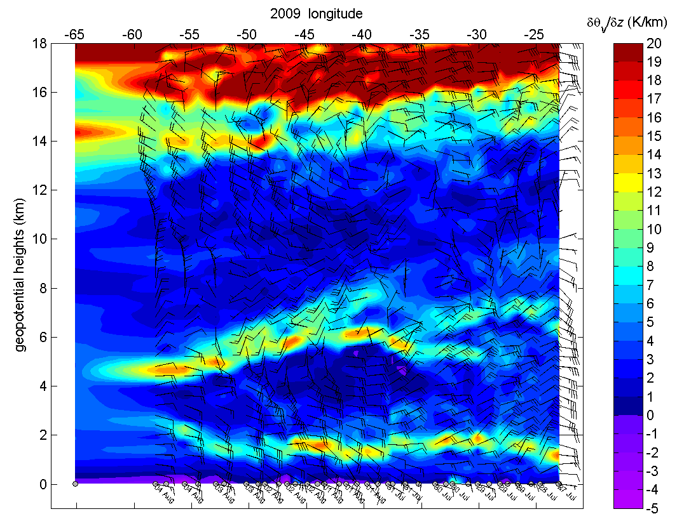
Tropospheric Virtual Potential Temperature Lapse Rate Latitudinal Cross-Section
Tropopause
Midlevel Inversion
AEJ
BL Inversion
Notes:
VPTLR – virtual potential temperature lapse rate

Slide 6
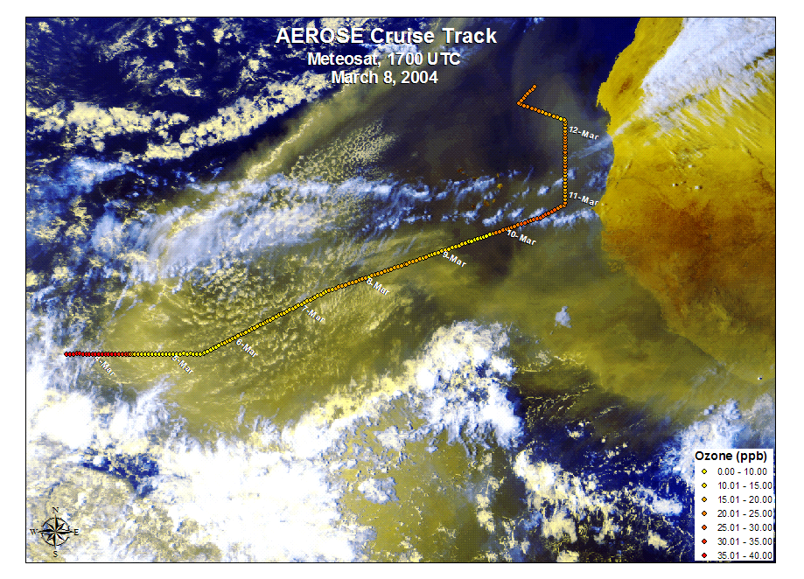
Notes:
Just as the aerosol surface composition is changed by the atmosphere, the aerosols change the chemistry of the atmosphere as they pass through. This image shows in situ ozone data along the cruise track overlaid on a satellite image of the dust storm that was encountered. The image shows the reduction in ozone within the main body of the air mass . Does dust destroy ozone?

Slide 7
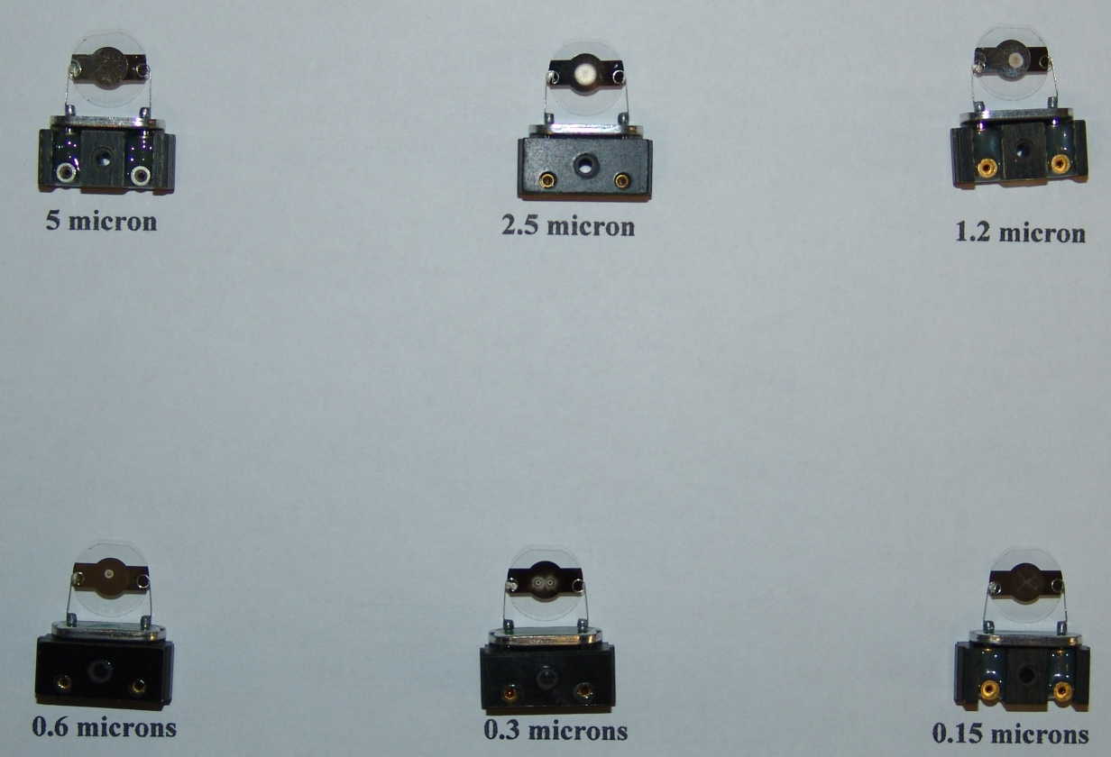
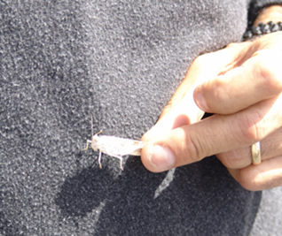
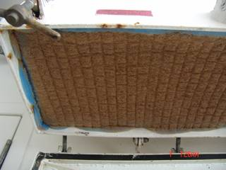
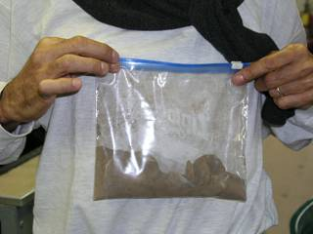
Remote Ocean Dust Sampling (2004)
Entrained Locusts
and
Direct Sedimentation

Slide 8
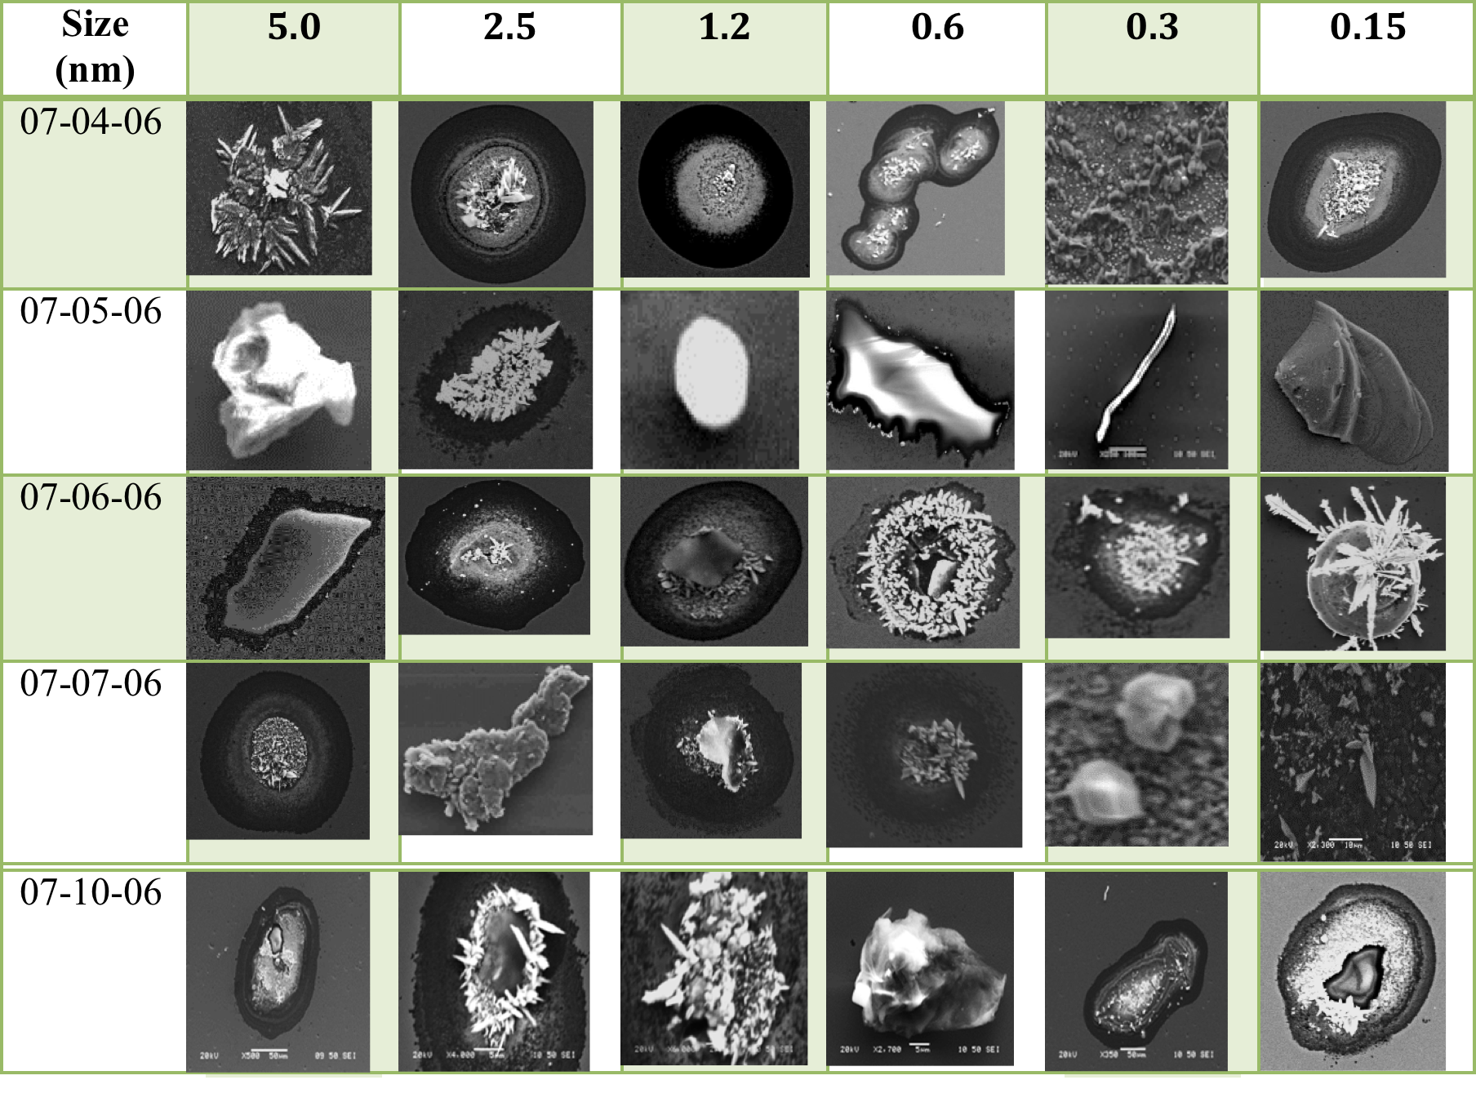
Samples of Particulate Morphologies Collected During AEROSE
Notes:
Here is a snapshot of the particle morphologies observed during the 2006 cruise. Scanning electron micrographs are presented from samples collected for each of six size fractions that were collected during the cruise within the same air mass. While this image is loaded with information one can clearly note that individual particles vary significantly by size – showing predominance of crystalline, fibrous, agglomerate, spheroidal, and sponge-like structures. The evolution of the morphologies also appears to be size-dependent.

Slide 9
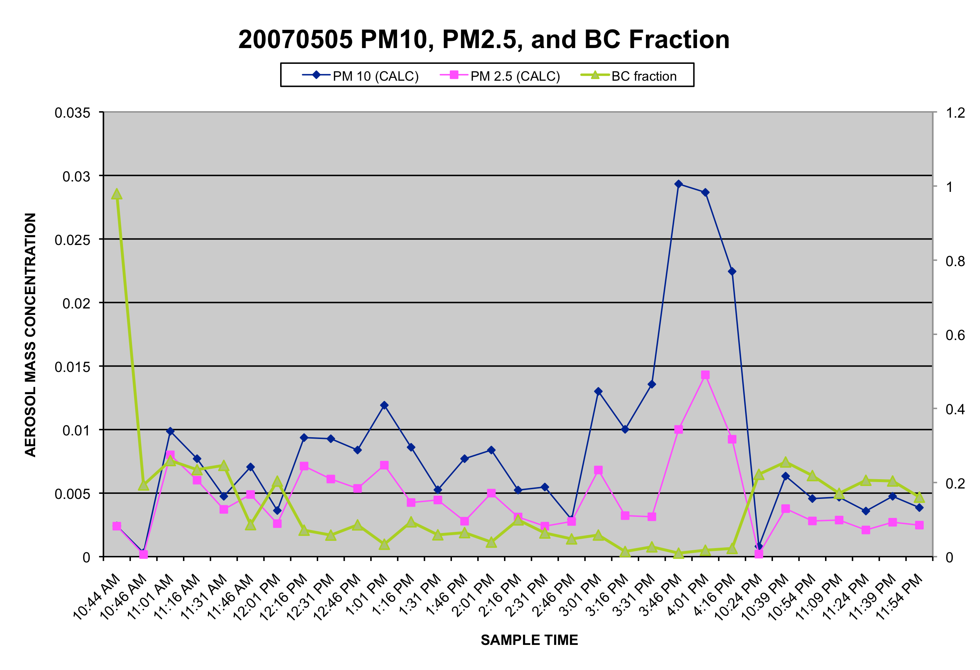
BC ranges from
1-5% of PM_{2.5}
Air Mass Changes

Slide 10
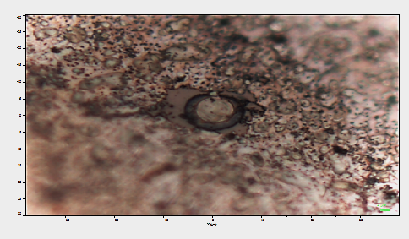
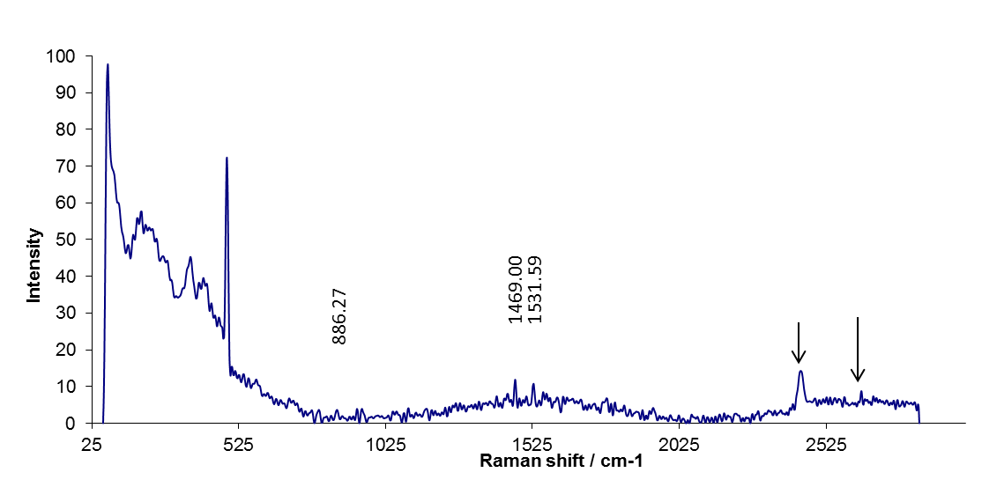
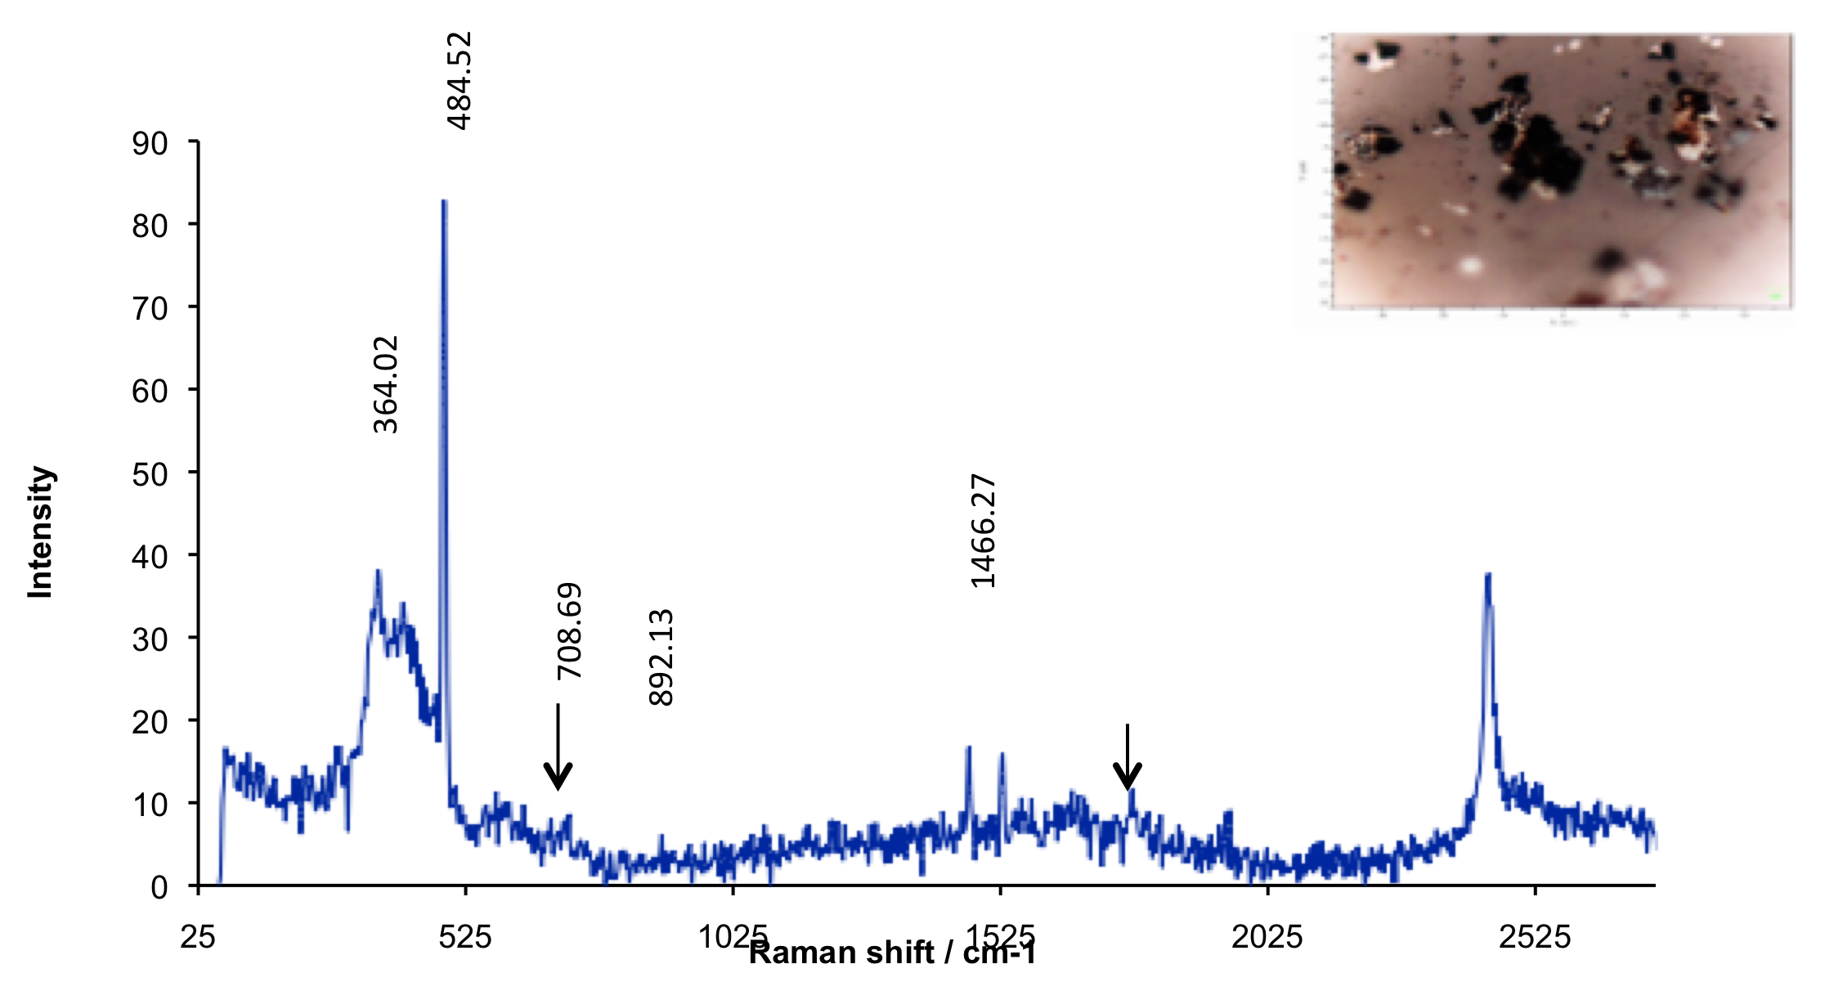
2550.33
2444.86
Assignment | Region (cm-1) | Intensity
Lattice vibrations | 10 - 200 cm-1 | Strong
Si-O-Si | 450-550 | Strong
C-Cl | 550-800 | Strong
C-S (aliphatic) | 630-790 | Strong
C-O-C | 800-970 | Medium
C-O-C asym | 1060-1150 | Weak
C=C | 1500-1900 | Strong
C(NO2) asym | 1530-1590 | Medium
C=O | 1680-1820 | Medium
-S-H | 2550-2600 | Strong
2437.62
1771.96
Notes:
July 6, 2006 is top sample – PM2.5 sample
July 27, 20009 is lower spectrum – PM2.5 sample

Slide 11
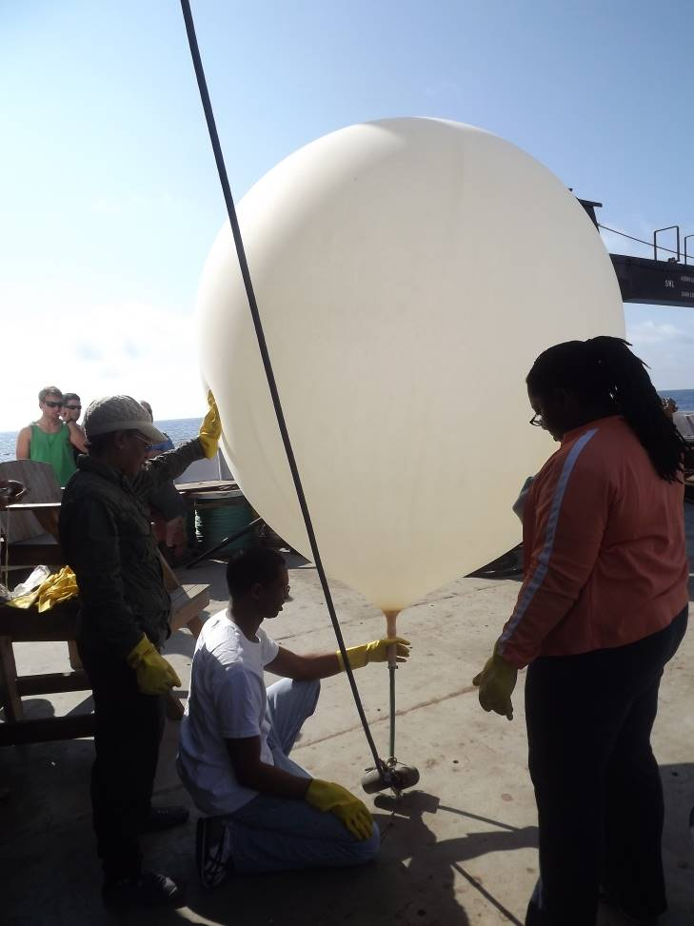
NCAS Research and Training Success Story
AEROSE
Milestones
Ten-year international research campaign aboard NOAA’s Class-I vessel Ronald H. Brown
50+ Students trained
17 Refereed NCAS publications and counting…
35+ National conference presentations…
Extensive NOAA collaborations (AOML, ESRL, ARL, NESDIS-STAR, NCEP)
10 PhD Theses developed from AEROSE and counting

Slide 12
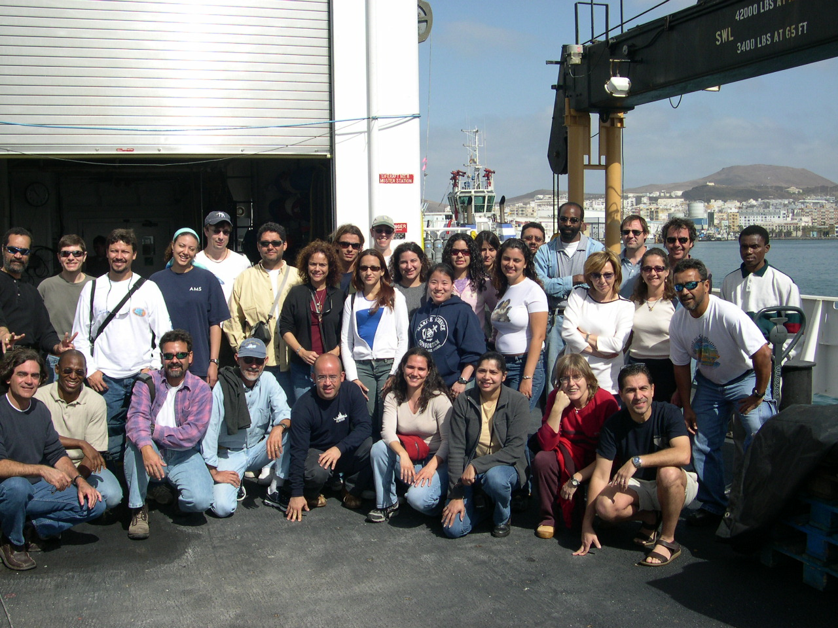
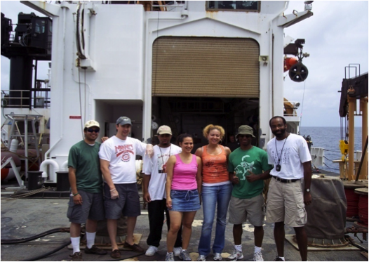
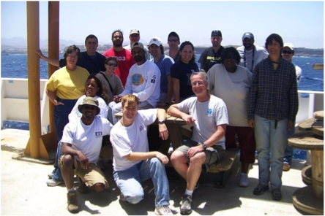
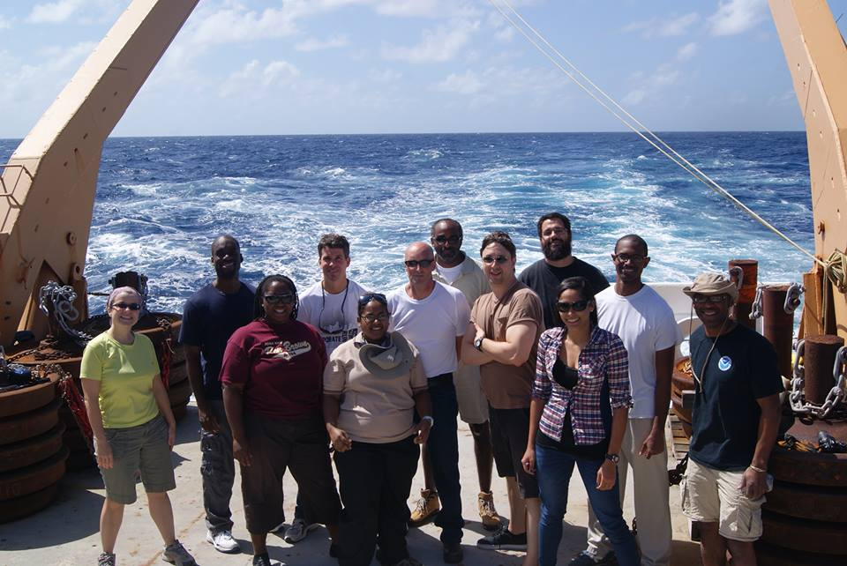
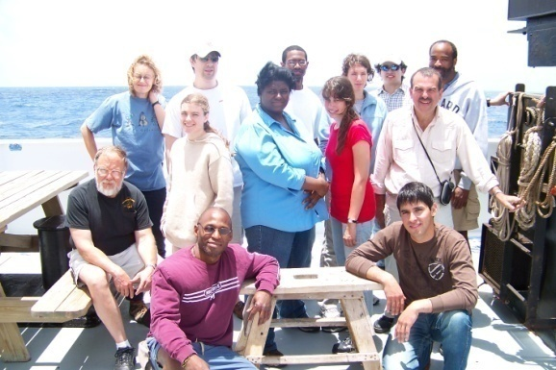

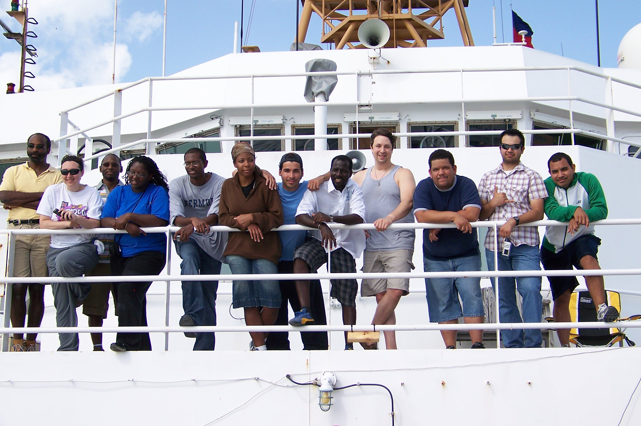
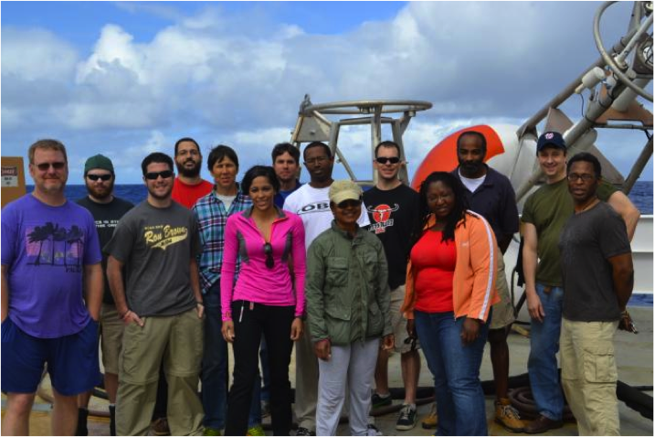
AEROSE Over The Years

